Slide 1
Java Server Pages-JSP
Waqar Yar

Slide 2
What is a JSP?
JavaServer Pages (JSP) is a technology that helps software developers create dynamically generated web pages based on HTML,XML, or other document types.
JSP is Java code inside an HTML page.
The JSP file is translated into .java file. Then the .java file is compiled into a servlet class file.

Slide 3
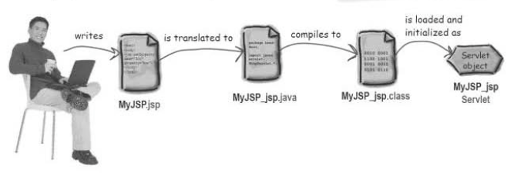
What is JSP?

Slide 4
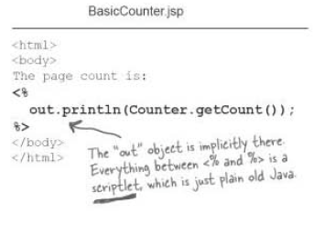
JSP - Example

Slide 5
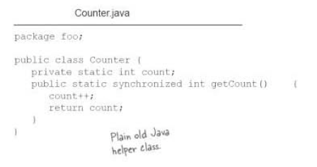
JSP - Example

Slide 6
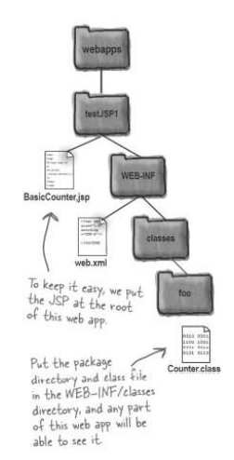
Directory structure of the Web Application.

Slide 7
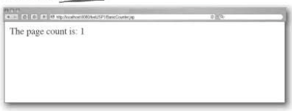

Slide 8
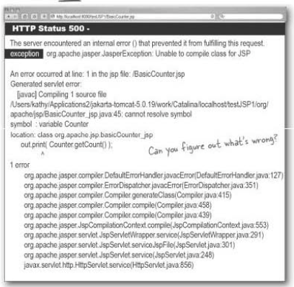

Slide 9
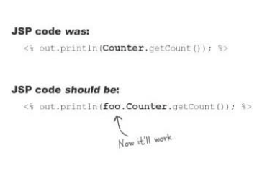
Package path

Slide 10
JSP - Directives
Directive is a way to give instructions to the container.
Three types of Directives:
Page
Include
Taglib

Slide 11
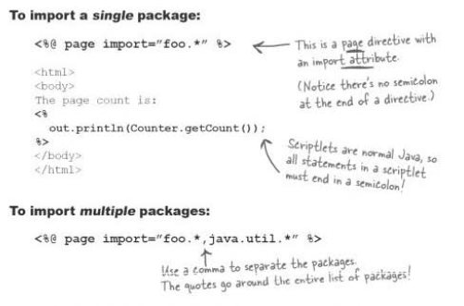
Page import directive

Slide 12
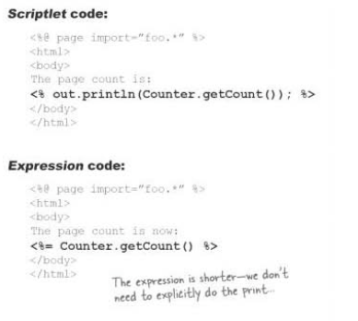
Expression Code

Slide 13

Types of JSP elements
The different types of JSP elements:

Slide 14
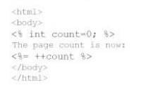

JSP – Declaring variables

Slide 15
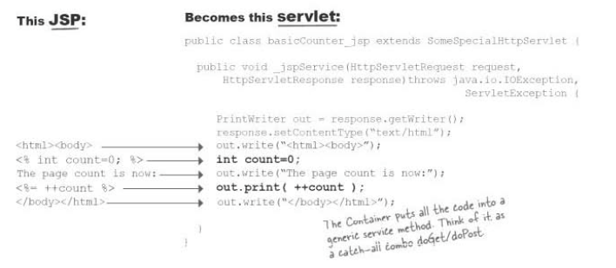
Conversion of JSP to Servlet

Slide 16
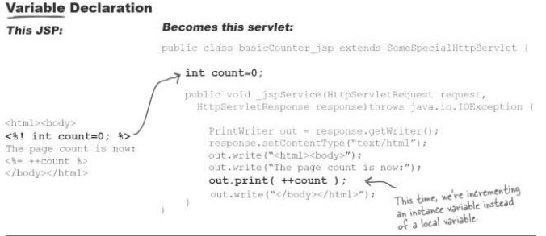
Declaring a variable in JSP

Slide 17
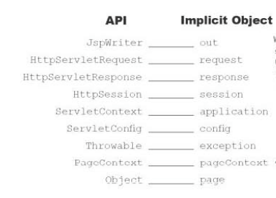
Implicit Object

